Slide 1
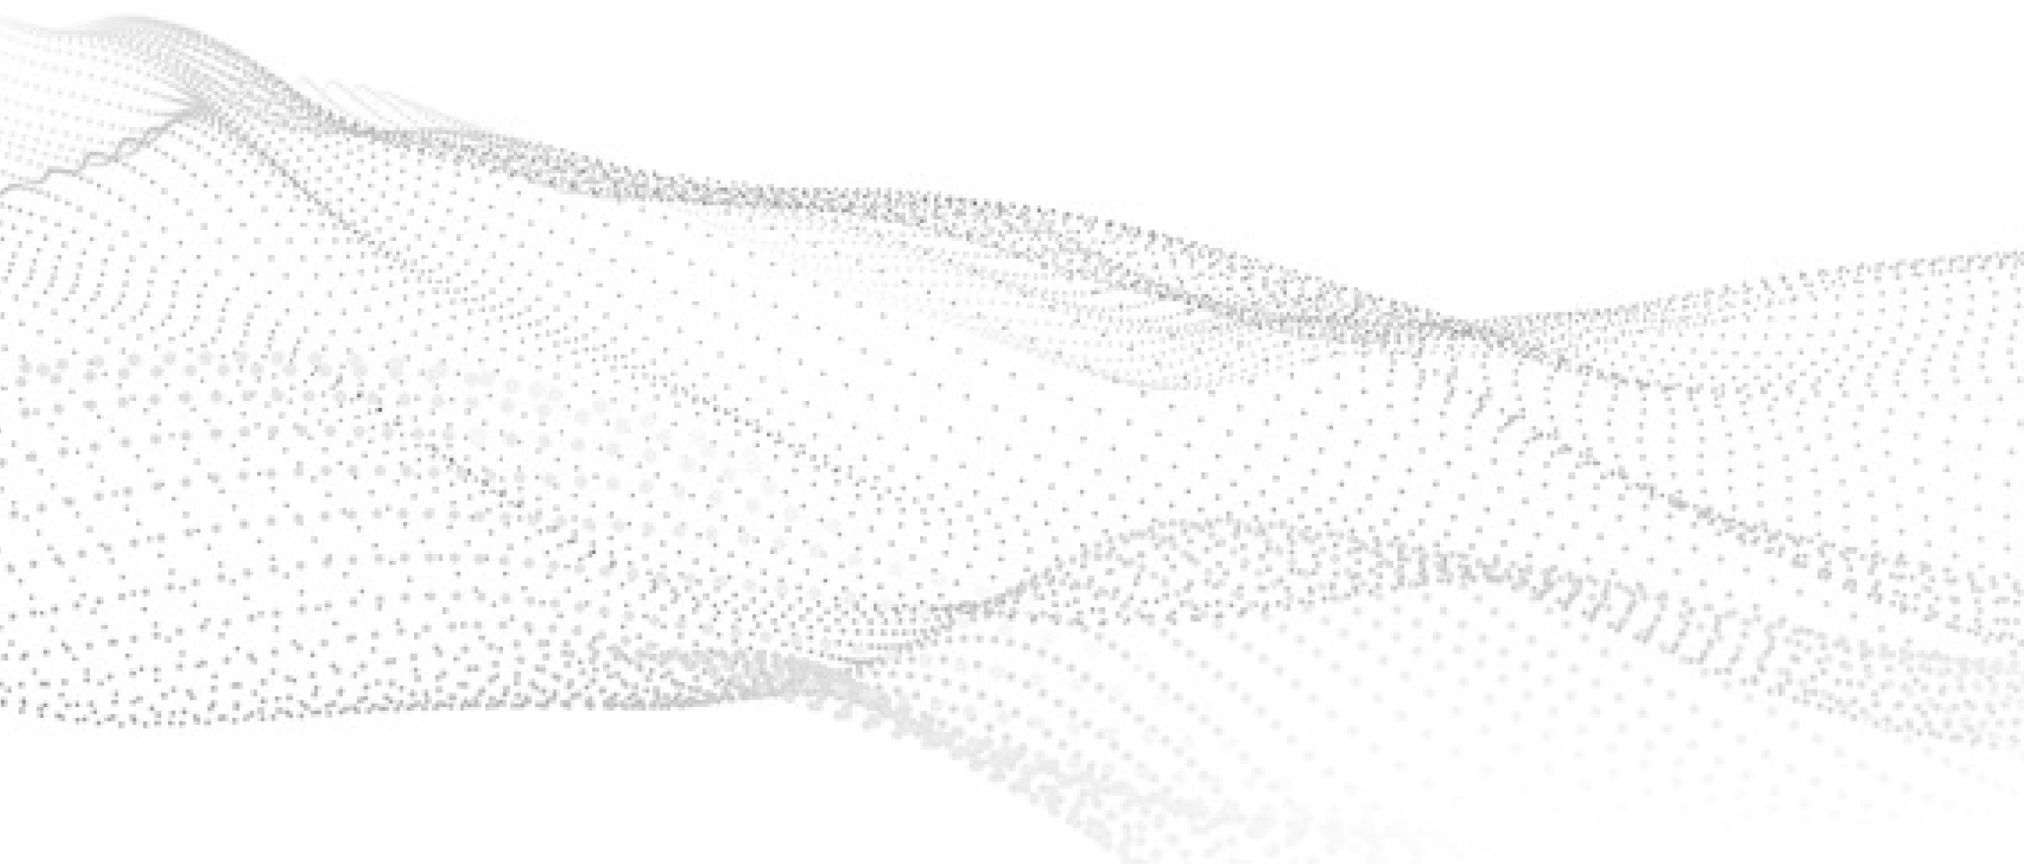




Computer Vision WOrkshop

Slide 2
CNN
What is a CNN?
A CNN is a neural network designed for images.
It uses convolution layers that exploit spatial locality (nearby pixels relate).
What is it used for?
Image classification
Object detection + localization
Segmentation (semantic/instance)
Video analysis (tracking, events)
Medical + industrial inspection

Slide 3
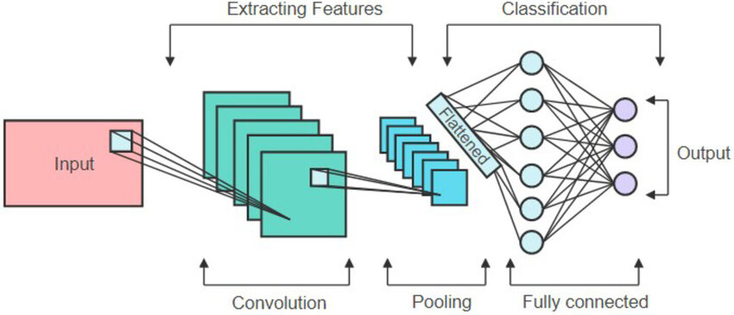
How do CNNS it work?

Slide 4
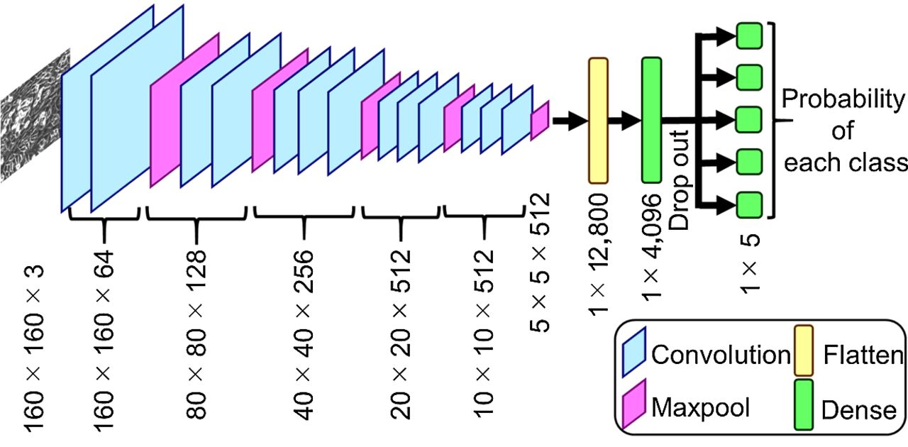
CNN Architecture

Slide 5
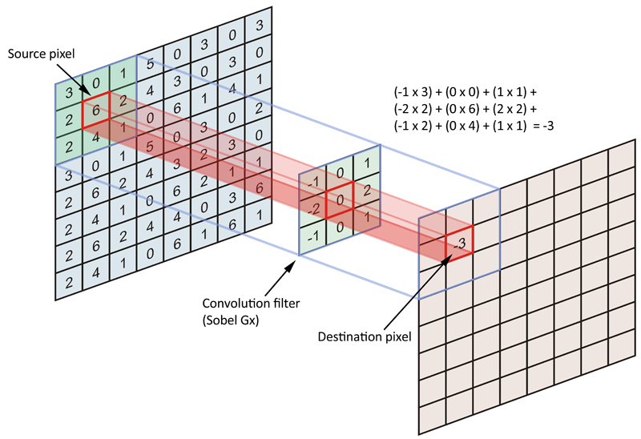
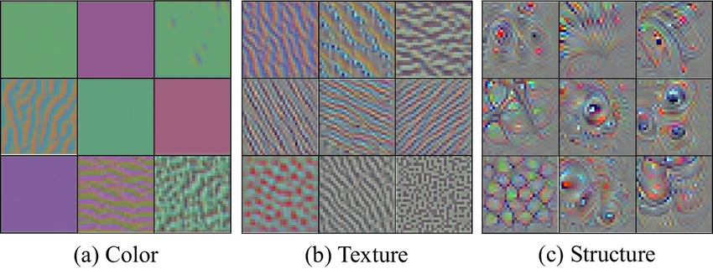
Convolutional layers

Slide 6
Batchnorm + Activation
What does batchNorm do and why?
Normalizes activations per mini-batch → more stable training
Often allows larger learning rates and faster convergence
Uses running mean/variance at inference time
What does activation do and why?
Activation adds nonlinearity so the model can learn complex patterns.
ReLU is the most common: it keeps positive signals and zeros out negatives.

Slide 7
Pooling + Dropout
What does pooling do and why?
Pooling reduces H×W while keeping the strongest features (max pool) or average context (avg pool).
Usually we do max pool between layers and average pool near the end for smooth results
Many modern CNNs downsize using just convolutional layers but with larger strides
What does drop out do and why?
Dropout randomly “turns off” neurons during training to reduce overfitting.
It forces the network to learn redundant, robust features.

Slide 8
Pooling Animation

Slide 9
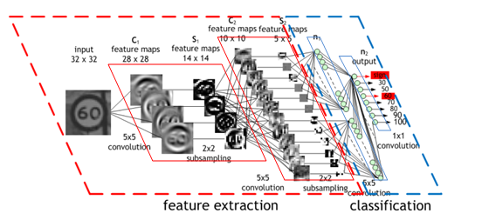
How do cnns learn?

Slide 10
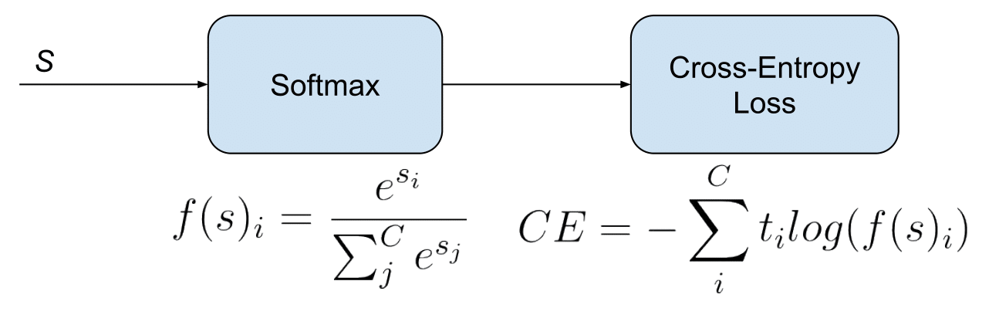
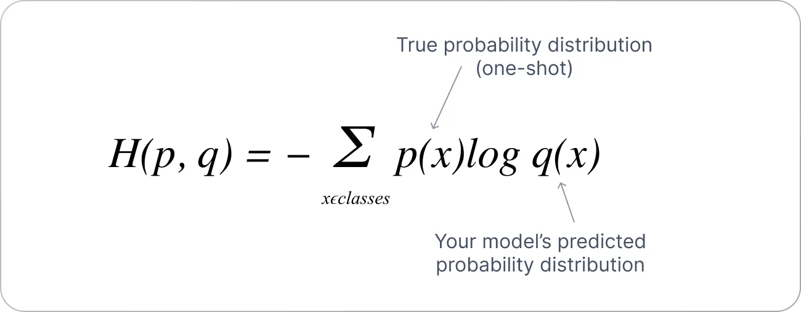
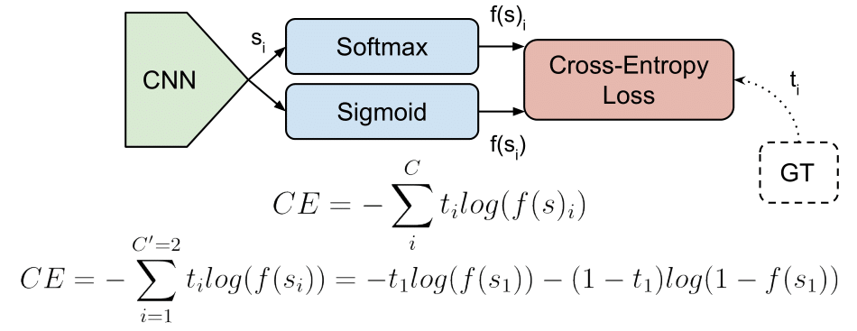
Classification Loss functions
Used when the output is a category.
Encourages the model to assign high probability to the true class.

Slide 11
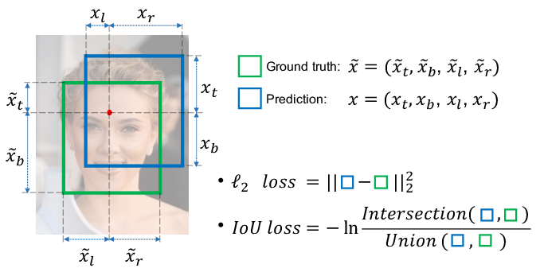
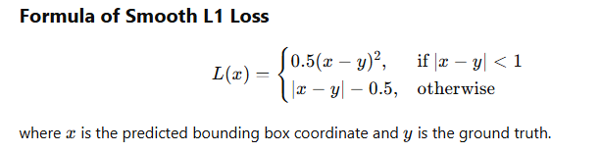
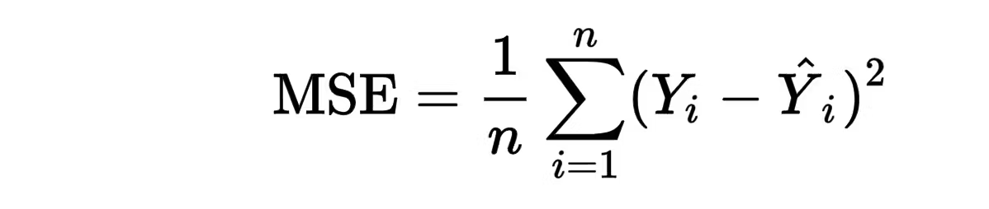
Regression/Localization Common Loss functions
MSE: for continuous targets (regression)
L1 / Smooth L1: common for bounding boxes
IoU-style losses: used in detection/segmentation

Slide 12
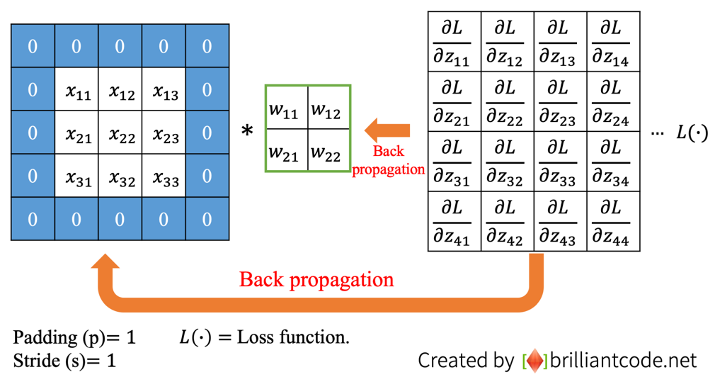
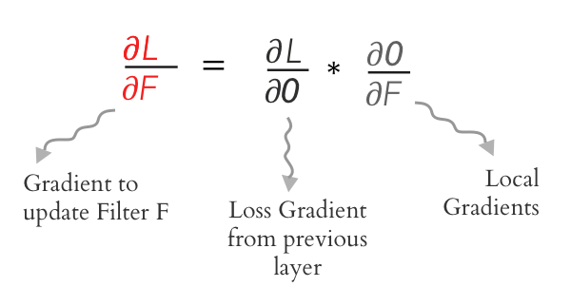
Backpropagation

Slide 13
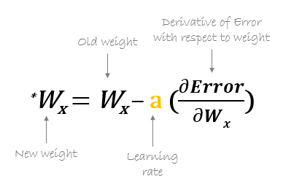
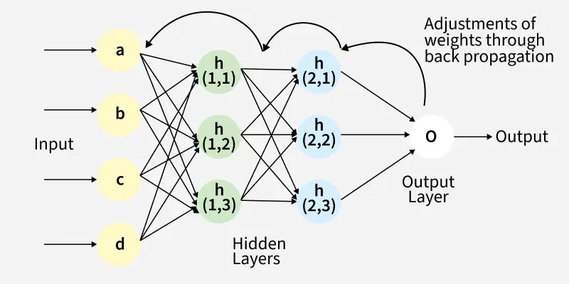
Weight Updates

Slide 14
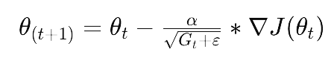
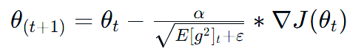
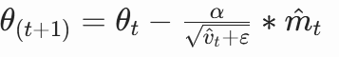
Optimization
Stochastic Gradient Descent(SGD)
Mini Batch Gradient Descent
SGD with Momentum
More Advanced Optimizers
AdaGrad
RMSProp
Adam

Slide 15
Vision transformers
What is a ViT?
A ViT applies Transformer encoders to images by turning images into a sequence of patch tokens.
Self-attention lets every patch interact with every other patch.
Where is it used?
Image classification at scale
Tasks needing global context
Vision-language and foundation models
Detection and segmentation (often as a backbone)

Slide 16
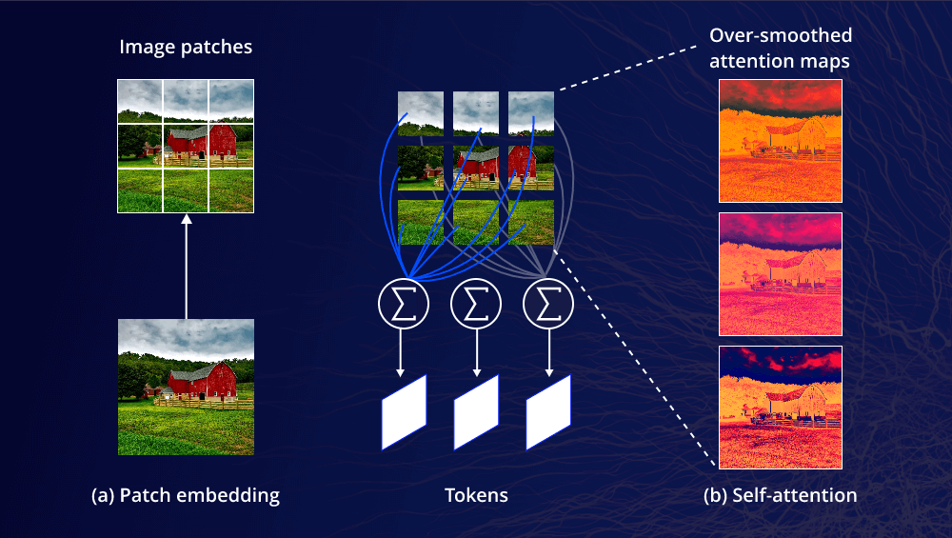
How do vision transformers work

Slide 17
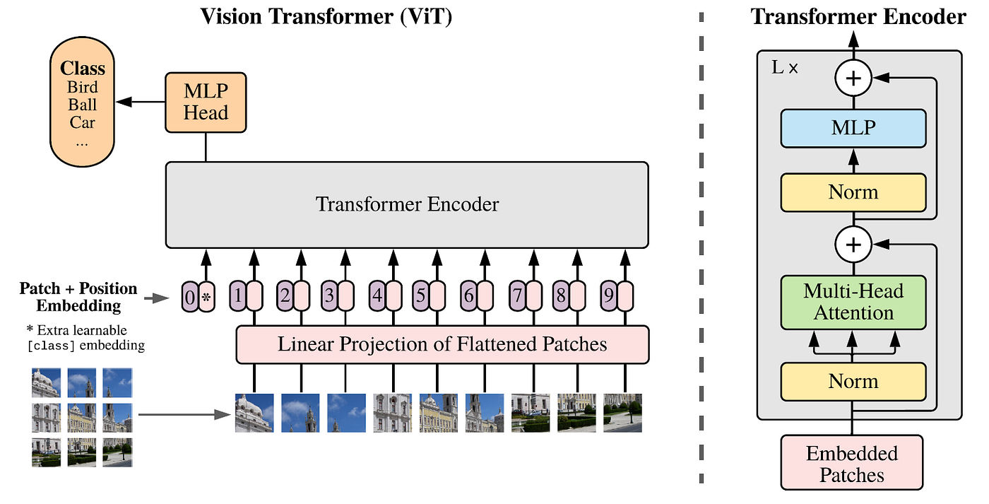
ViT Architecture

Slide 18
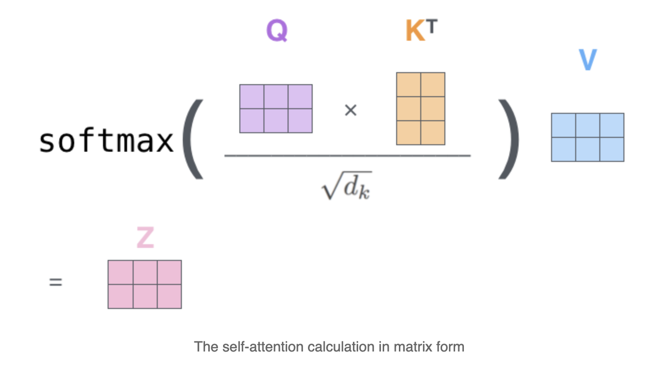
Attention MechanisM
Query (Q): The query vector represents what the current token is looking for in other tokens.
Key (K): The key vector represents what features a token offers so other tokens can decide how relevant it is to their queries.
Value (V): The value vector contains the actual information that gets passed along once a token is selected as relevant.

Slide 19
ViT vs CNN
 | Pros | Cons
CNN | •High accuracy with strong local structure •Efficient on GPUs •Robust to small noise/variations •Great as feature backbones | •Global context can be harder to capture •Often needs task-specific heuristics in detection •Can be hard to interpret
Vit | •Captures global context (long-range deps) •Scales well with large data + model size •Parallel computation on tokens •Strong learned representations | •Data-hungry vs CNNs •Attention cost grows ~ O(N²) with #patches •Weaker built-in local bias •Sensitive to patch size / hyperparams

Slide 20
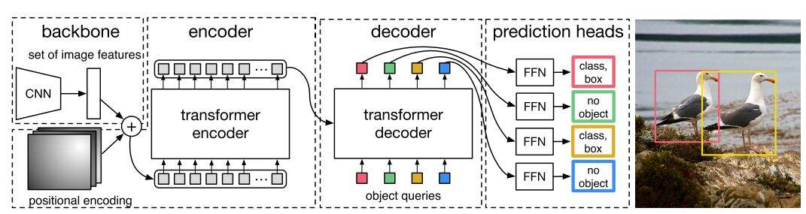
Hybrid Models
Combing ViTs and CNNs gives the best results for more complex tasks!
Detection Transformer Architecture:

Slide 21
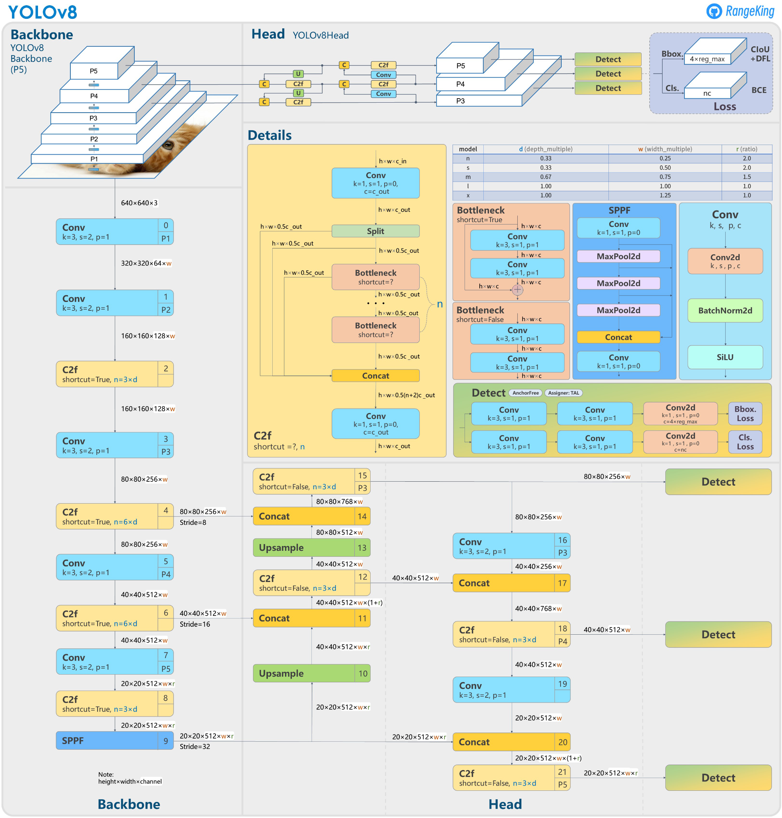
Complex Models

Slide 22
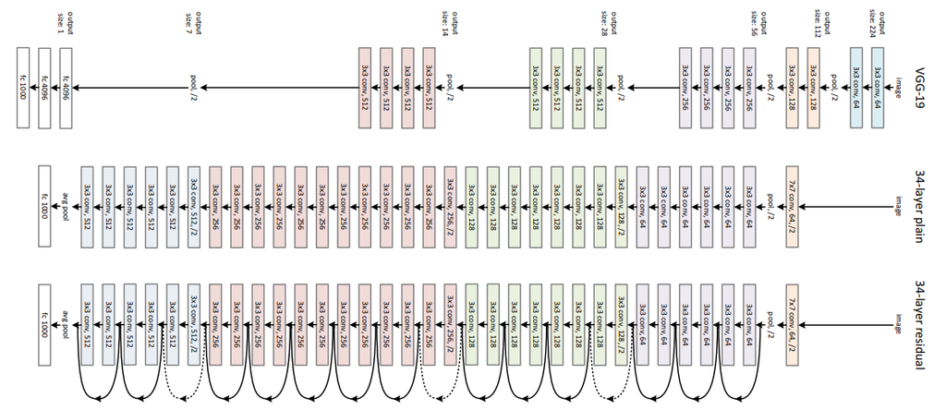
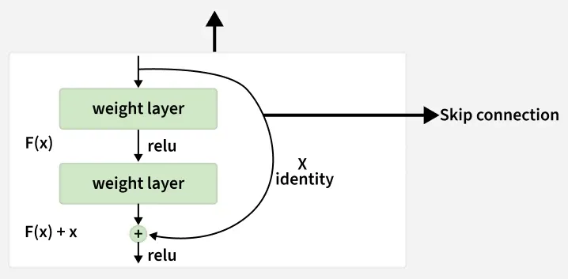
ResNet

Slide 23
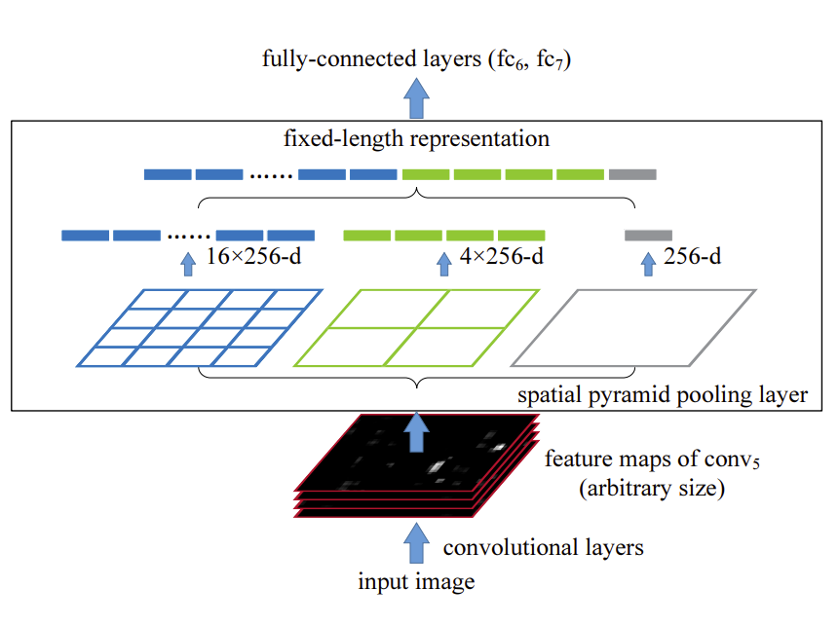
Spatial Pyramid Pooling

Slide 24
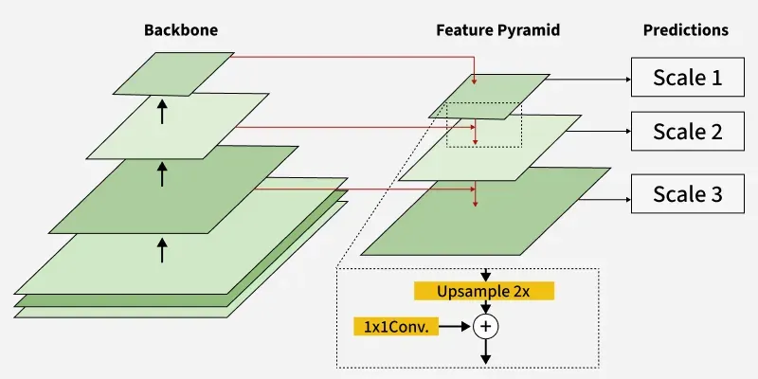
Feature Pyramid Network

Slide 25
Work CIted
GeeksforGeeks. Introduction to Convolutional Neural Networks (CNNs). https://www.geeksforgeeks.org/machine-learning/introduction-convolution-neural-network/
GeeksforGeeks. Activation Functions in Neural Networks. https://www.geeksforgeeks.org/machine-learning/activation-functions-neural-networks/
Rosebrock, A. Convolutional Neural Networks (CNNs) and Layer Types. PyImageSearch, 2021. https://pyimagesearch.com/2021/05/14/convolutional-neural-networks-cnns-and-layer-types/
GeeksforGeeks. Backpropagation in Convolutional Neural Networks. https://www.geeksforgeeks.org/computer-vision/backpropagation-in-convolutional-neural-networks/
GeeksforGeeks. Residual Networks (ResNet) in Deep Learning. https://www.geeksforgeeks.org/deep-learning/residual-networks-resnet-deep-learning/
GeeksforGeeks. Convolutional Neural Network (CNN) in Machine Learning. https://www.geeksforgeeks.org/deep-learning/convolutional-neural-network-cnn-in-machine-learning/
GeeksforGeeks. Optimization Rules in Deep Neural Networks. https://www.geeksforgeeks.org/deep-learning/optimization-rule-in-deep-neural-networks/
Anonymous Authors. [ArXiv Preprint] arXiv:2408.15857, 2024. https://arxiv.org/html/2408.15857v1
GeeksforGeeks. Feature Pyramid Network (FPN). https://www.geeksforgeeks.org/computer-vision/feature-pyramid-network-fpn/

Slide 26
Work CIted
Simonyan, K., & Zisserman, A. Very Deep Convolutional Networks for Large-Scale Image Recognition. arXiv:1406.4729, 2014. https://arxiv.org/abs/1406.4729
Codecademy. Transformer Architecture: Self-Attention Mechanism. https://www.codecademy.com/article/transformer-architecture-self-attention-mechanism
GeeksforGeeks. Vision Transformer (ViT) Architecture. https://www.geeksforgeeks.org/deep-learning/vision-transformer-vit-architecture/
V7 Labs. Vision Transformers: A Practical Guide. https://www.v7labs.com/blog/vision-transformer-guide
Codecademy. Vision Transformers: Working and Architecture Explained. https://www.codecademy.com/article/vision-transformers-working-architecture-explained
Carion, N., et al. End-to-End Object Detection with Transformers (DETR). arXiv:2005.12872, 2020. https://arxiv.org/abs/2005.12872

